Slide 1
SWE-4805: Software Verification and Validation
Grey Box Testing
Md. Nazmul Haque
Lecturer, IUT
Department of Computer Science and Engineering
Islamic University of Technology
January 04, 2022

Slide 2
Contents
Contents
Grey box Testing

Slide 3
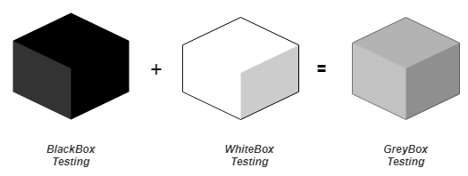
Verification
Grey Box Testing
A software testing method to test the software application with partial knowledge of the internal working structure.
A combination of black box and white box testing because it involves access to internal coding to design test cases as white box testing and testing practices are done at functionality level as black box testing.

Slide 4
Verification
Grey Box Testing
Identifies context-specific errors that belong to web systems. For example; while testing, if tester encounters any defect, then he makes changes in code to resolve the defect and then test it again in real time. It concentrates on all the layers of any complex software system to increase testing coverage.
Gives the ability to test both presentation layer and internal coding structure. It is primarily used in integration testing and penetration testing.

Slide 5
Verification
Why Grey Box Testing ?

Slide 6
Verification
Example of Grey Box Testing
While testing a website, if the tester clicks on any link, and it comes up with an error, the Grey box tester can make changes in the HTML code to check the same.
In this particular scenario, white box testing is being done by changing the code and as the tester is testing the changes at the front end–black box testing is also being done. The combination of the White box and Black box results in Grey box testing.

Slide 7
Verification
Example of Grey Box Testing
Grey box testers can analyze the error codes and explore the cause in detail if they have knowledge and access to the error code table in which cause is provided against the error code. Say, the webpage gets an error code as “Internal server error 500” and the cause against this error is shown as server error in the table.
Using this information, a tester can further analyze the issue and provide the details to the developer, rather than just raising the issue to them.

Slide 8
Verification
Example of Grey Box Testing
Grey box testers can analyze the log files themselves to find the root cause for the issue.
The Grey box tester can easily analyze low performance, crashes in the application, or other issues.

Slide 9
Verification
Steps of Grey Box Testing
Select input: White box and Black box testing inputs to be identified.
Identify output: Outputs to be identified for the inputs selected in step 1.
Identify the key paths: All the major and key paths to be identified for the testing phase.
Identify subfunctions: Subfunctions to be identified to perform testing at the next level, i.e. to test more in-depth into the product.
Identify subfunction input: Inputs for subfunction to be identified in this step.
Identify Subfunction Output: Outputs to the above-selected input for subfunctions to be selected or identified.

Slide 10
Verification
Steps of Grey Box Testing
Execution of subfunction: Test case for subfunction to be executed.
Verification of executed subfunction: Verification to be done for the execution done in Step 7 to identify whether the test results are as expected or not.
The test cases designed for Greybox testing includes Security related, Browser related, GUI related, Operational system related and Database related testing.

Slide 11
Verification
Techniques of Grey Box Testing
Matrix Testing: Software developers provide all the variables in a program, along with the technical and business risks that are linked with them. The matrix testing technique tests the risks defined by the developers. Matrix technique states all the used variables in a program. This technique helps to identify and remove the variables which are not being used in the program and, in turn, helps to increase the speed of the software.
Regression Testing: Regression testing is performed when any change is done in the software or any defect is fixed. It is done to ensure that a new change or fix done has not impacted any existing functionality of the software.

Slide 12
Verification
Techniques of Grey Box Testing
Orthogonal Array Testing or OAT: This testing technique is used more for complex functionalities or applications, as this technique is utilized when maximum coverage of code is required with minimum test cases and has large test data with n number of combinations.
Pattern Testing: Pattern Testing is performed based on the previous defects found in the software. Defect record is analyzed for the cause of defects and test cases are created keeping the defects and their cause in knowledge to find defect before the software goes into production.

Slide 13
Verification
Advantages of Grey Box Testing
Users and developers have clear goals while doing testing.
Gray box testing is mostly done by the user perspective.
Testers are not required to have high programming skills for this testing.
Overall quality of the product is improved.
By doing gray box testing, benefits of both black box and white box testing is obtained.
Gray box testing is unbiased. It avoids conflicts between a tester and a developer.
Gray box testing is much more effective in integration testing.

Slide 14
Verification
Disadvantages of Grey Box Testing
Defect association is difficult when gray testing is performed for distributed systems.
Limited access to internal structure leads to limited access for code path traversal.
Because source code cannot be accessed, doing complete white box testing is not possible.
Gray box testing is not suitable for algorithm testing.
Most of the test cases are difficult to design.

Slide 15
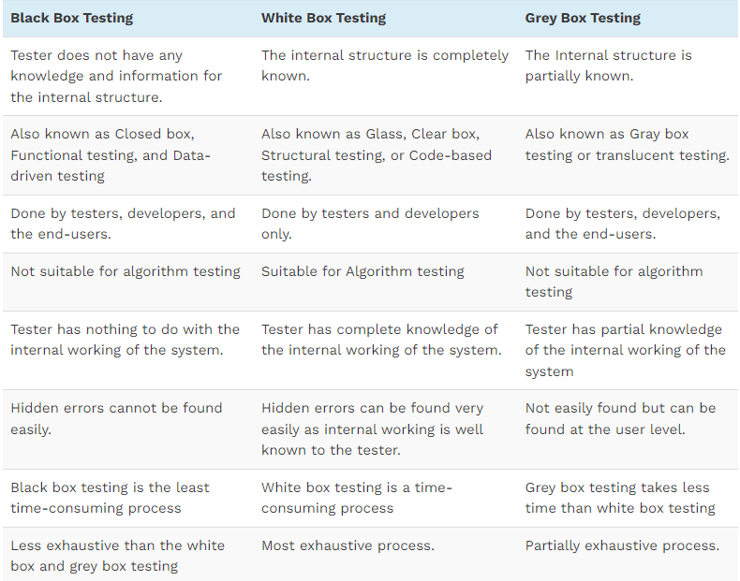
Verification
Difference Between Black Box, White Box, And Grey Box Testing

Slide 16
ANY QUESTION ?
THANK YOU !

Slide 17
Acknowledgements
Acknowledgements
[1] Chauhan, Naresh. Software Testing: Principles and Practices. Oxford university press, 2010.
[2] https://www.javatpoint.com/grey-box-testing
[3]https://www.javatpoint.com/black-box-testing-vs-white-box-testing-vs-grey-box-testing

